Slide 1
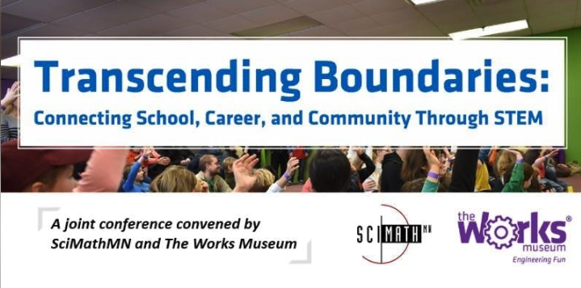
Teaching Computer Science (and AI) with Low-Cost Robots
Dan McCreary, CoderDojo

Slide 2
Teaching Computer Science with Low-Cost Robots
Room 155 Afternoon Session 2 | 2:30 - 3:30 p.m.
Dan McCreary, CoderDojo Twin Cities
Over a three-year period, a team at CoderDojo Twin Cities designed and tested a $25 Arduino robot that can be used to engage both beginning and advanced students in fun and learning of more than 20 computer science concepts through a variety of hands-on labs. Participants will have a chance to experience this robot, learn how AI concepts can be taught using Raspberry Pi, discover available resources, and consider how to integrate these materials into their classrooms or programs.

Slide 3
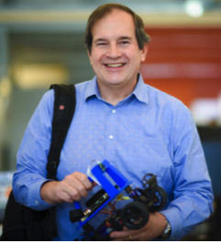
Hello, my name is
Dan
Distinguished Engineer at Optum Healthcare (50K technical staff)
Focused on AI and teaching AI
CoderDojo volunteer (5 years)
IoT Hackday – LED costumes
Cofounder: AI Racing League
Interested in teaching methodologies and learning content recommendation systems
Personal Mission:
Help teachers and mentors integrate advanced technology into the classroom.

Slide 4
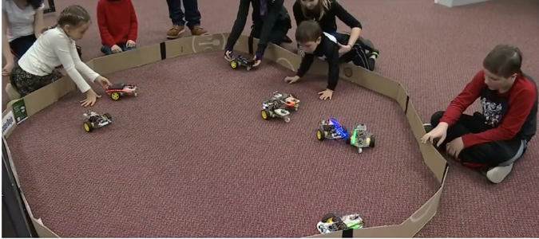
Kids love robots!
Robot Day at "The Works" (April 2018)
"Hands-on" for kids 5 to 12 years
Notes:
https://www.youtube.com/watch?list=PLmXh30-EMTVtWAIGz_7pImSKRsJ_z8Yn1&v=pZHZEA6dJro

Slide 5
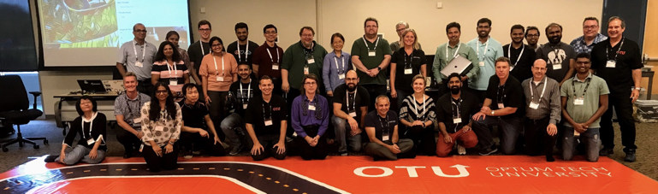
Teaching Non-Programmers about AI
Create fun hands-on activities to teach AI
Use AI to teach AI

Slide 6
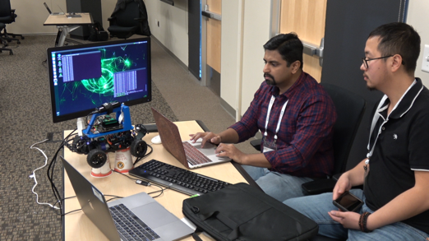
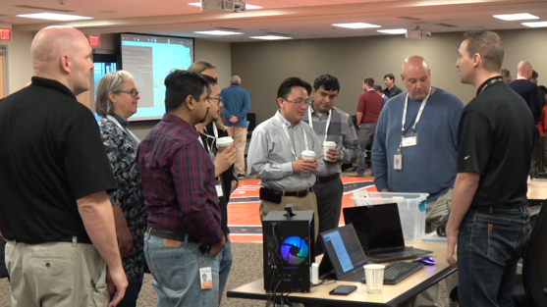
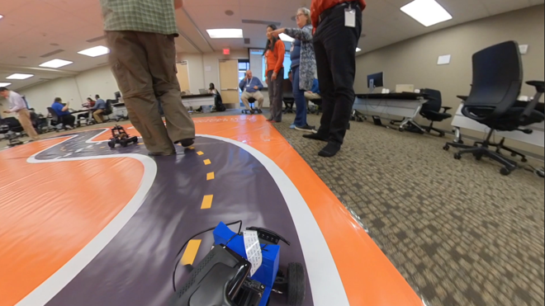
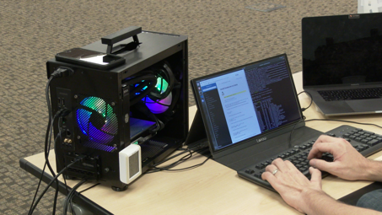
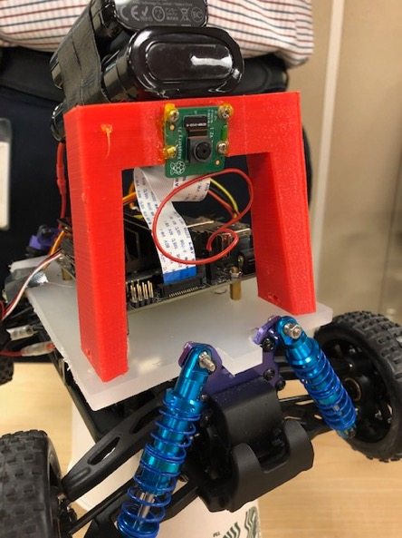
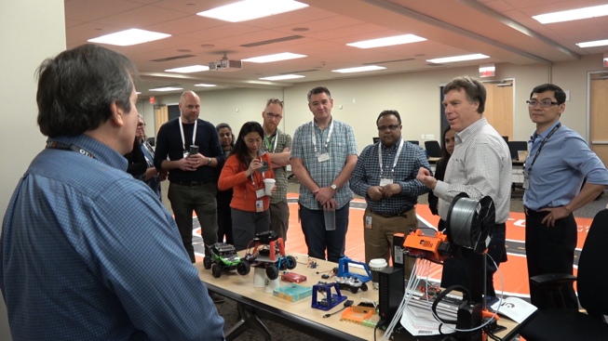
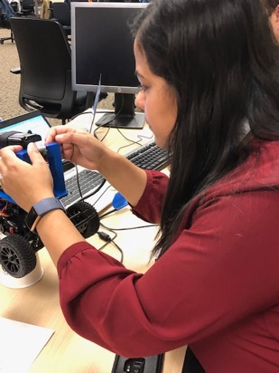
AI Racing
Teaching AI at Optum

Slide 7
Key Questions
How can we leverage inexpensive hardware (Arduino and Pi)?
What exactly is AI and how is it different?
How will AI impact STEM education?
How will we teach AI concepts in our schools, colleges and universities?
Case Studies
Google’s Teachable Machine
The DonkeyCar Movement
Learning Recommendation Systems: Knowledge Spaces
The Futurists Academy
How will we Training our Teachers?
Conclusion

Slide 8
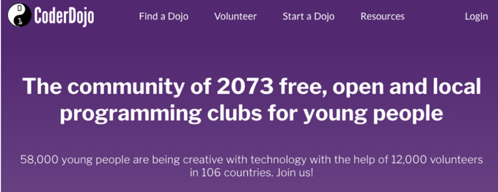
About CoderDojo
http://CoderDojo.org

Slide 9


About CoderDojo in Minnesota
Southwest (Uptown)
North Metro
St. Paul (3)
Northfield
Rochester
Worthington

Slide 10
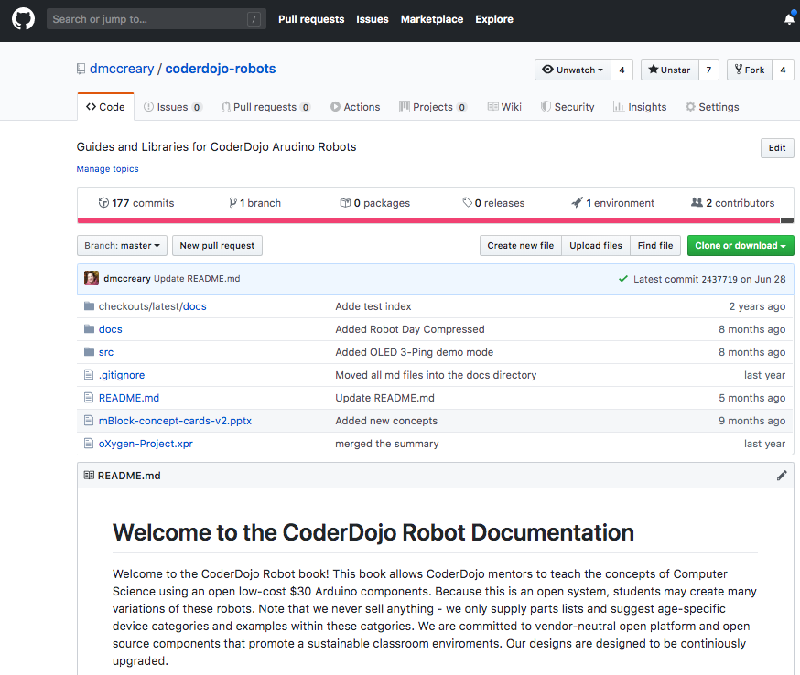
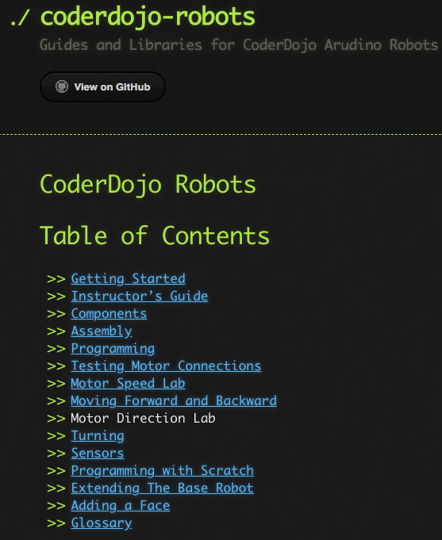
CoderDojo Robots – Open Source
https://github.com/dmccreary/coderdojo-robots
GitHub Pages Documentation

Slide 11
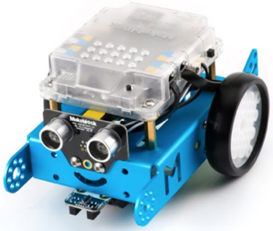
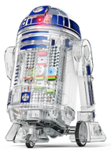
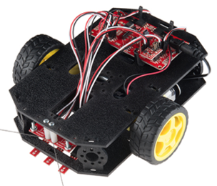
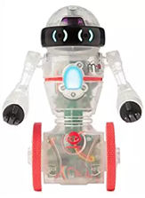
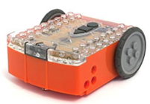
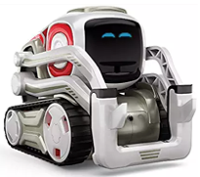
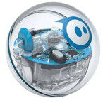
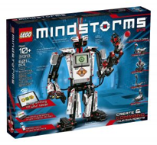
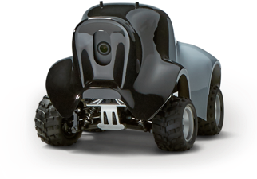
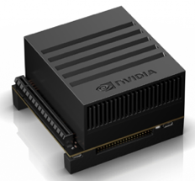
Many options
Droid Inventor
littleBits ($99)
SparkFun
Inventor Kit ($126)
Edison ($49)
Coder MIP ($49)
MBot ($79)
Cozmo ($129)
Sphero 2.0 ($179)
Lego Mindstorms
($349)
AWS DeepRacer ($499) $249
NIVIDIA Jetson Xaviar ($2,500)
($1,250)

Slide 12
$25 Robot Platform for Teaching Programming
https://www.instructables.com/id/Collision-Avoidance-Robot-for-Teaching-Programming/

Slide 13
FaceBot - $40 with 64x128 OLED Screen
https://www.instructables.com/id/FaceBot/

Slide 14
Artificial Intelligence
Symbolic
Reasoning
Machine Learning
Knowledge Representation
Focus on Machine Learning

Slide 15
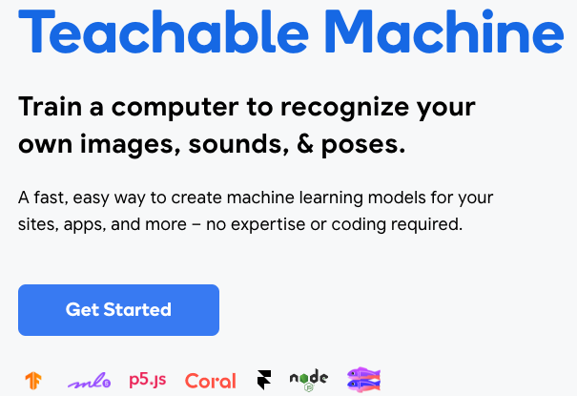
Google’s Teachable Machine
https://teachablemachine.withgoogle.com/

Slide 16
AI Racing League
The AI Racing League is a platform for AI education that integrates hands on learning using low-cost robots.
Cofounded with Jon Herke
First event in August of 2019

Slide 17

AI Racing League Scope and Partners
Collaborators
AI Racing League aims to expose and develop artificial intelligence, robotics, systems engineering, IoT (sensors), 3D printing, and automation based skills for program participants.
Give back – Bridge Optum technical talent with local communities (especially underserved or underrepresented populations)
Create a technical talent pipeline – Build out the future of technical talent
Foster internal cross-team collaboration – Build up Optum Technology culture and reach non-technical colleagues
Enhance technical knowledge – Create exposure to emerging technologies
Initial sponsors/ pilot partners
Notes:
Photo by Mimi Thian on Unsplash
Photo by tribesh kayastha on Unsplash
Photo by Perry Grone on Unsplash

Slide 18
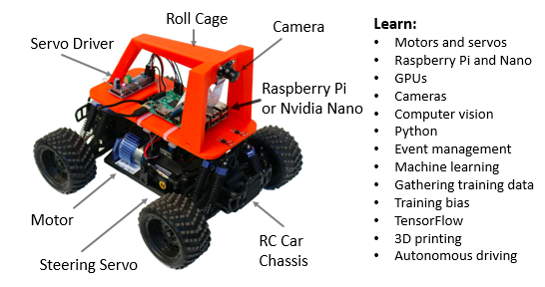
AI Racing League Curriculum
Our platform is inspired by the internationally viral Donkey® Cars movement which uses a Raspberry Pi and camera on a remote-control (RC) car chassis.
Donkey® Cars are low cost cars ($250) that use open source software
Started in California and has grown virally across the world
Users write python code and use deep learning neural networks to train their car to drive itself around a track.
Notes:
Photo by Mimi Thian on Unsplash
Photo by tribesh kayastha on Unsplash
Photo by Perry Grone on Unsplash

Slide 19
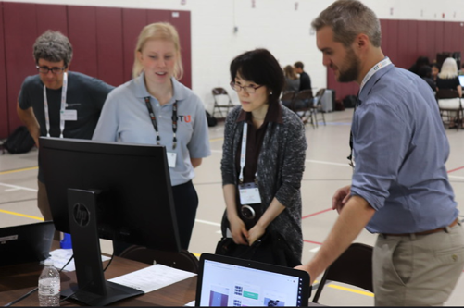

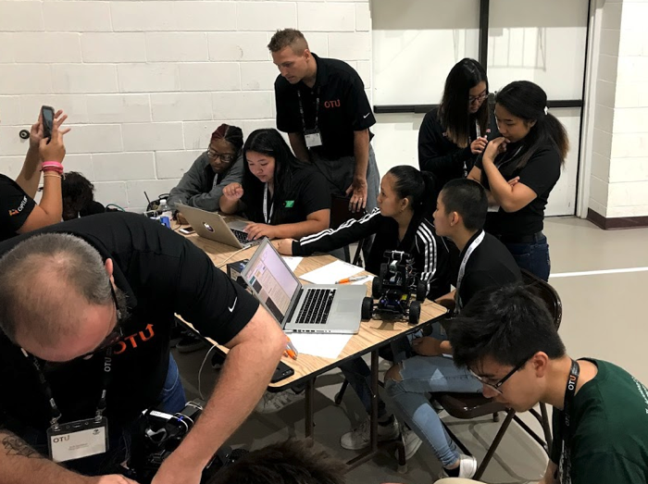
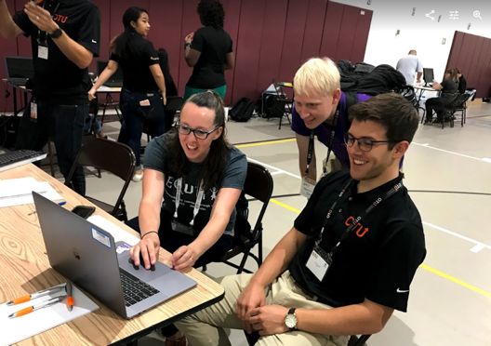
AI Racing League Launch Event, August 6
65 registrants 23 Optum mentors
34 attendees 22 external attendees
(65% of participants)
Notes:
Photo by Mimi Thian on Unsplash
Photo by tribesh kayastha on Unsplash
Photo by Perry Grone on Unsplash

Slide 20


AI Racing League Launch Event, Concept Cards
Nvidia Nano
Hardware
Python
Machine Learning
Intermediate Concepts
Starting Concepts
Computer Vision
TensorFlow
Finish!
One double-sided laminated card per concept. Activities and suggested questions on the front. Answers on the back.
Starting Concepts (green borders) have no dependencies on other concepts. They should be attempted first.
Intermediate Concepts (blue borders) should be for students that have completed most of the starting concepts or are already familiar with the topic.
Finishing Concepts (black borders) should be attempted after the intermediate concepts are mastered.
Training a Model
Finishing Concepts
Autonomous
Driving!
Notes:
Photo by Mimi Thian on Unsplash
Photo by tribesh kayastha on Unsplash
Photo by Perry Grone on Unsplash

Slide 21


AI Racing League Launch Event, Feedback
“Open source projects are really about building a community and specifically educating people in Computer Science, Robotics and Machine Learning. It is rare to find an organization whose mission is so aligned with ours. We hope to build a lasting partnership with Optum.” - Adam Conway, Donkey® Cars Co-Founder
“I was so impressed! I look forward to more opportunities to learn about your incredible program!” - Andrea Touhey, Educator | Founder, MathTreks
“It was an amazing experience how all these technologies were put together. Job well done.” - Mohamed Hassan, Big Data Engineer, Thomson Reuters
Notes:
Photo by Mimi Thian on Unsplash
Photo by tribesh kayastha on Unsplash
Photo by Perry Grone on Unsplash

Slide 22
What is it?
A fun way to learn AI using 1/16 scale remote-control car with a Raspberry Pi and camera
Built around the “Donkey Car” system that has gone viral worldwide
Requires engineering resources to be useable in a classroom or corporate events project

Slide 23
Backstory on AI Racing
Started by innovators in the Bay Area
Started as a small group of six people and doubled each quarter
Branded as a “Donkey Car” because the car was considered “ugly” by design

Slide 24
Amazon November 2018 Announcement
https://venturebeat.com/2018/11/28/amazon-launches-autonomous-racing-league-and-399-deepracer-car/

Slide 25
Amazon Deep Racer
Large well funded project started by amazon
Tied to AWS cloud-based training
Designed to teach AI concepts (Reinforcement Learning)
No open architecture
$400 retail list
Designed for colleges, makers and eventually high-school robotics

Slide 26
Donkey Car
Roll Cage
Servo Driver
Camera
Raspberry Pi
Brushed Motor
Chassis
Steering Servo
Notes:
https://www.google.com/search?q=donkey+car&source=lnms&tbm=isch&sa=X&ved=0ahUKEwi45-TSrebhAhUQKKwKHcDOCPQQ_AUIDigB&biw=1680&bih=899#imgrc=_gn_fmtYlF3_cM:
https://www.google.com/url?sa=i&source=images&cd=&cad=rja&uact=8&ved=2ahUKEwiur8XasObhAhUMWqwKHeOCCFIQjhx6BAgBEAM&url=https%3A%2F%2Fdocs.aws.amazon.com%2Fdeepracer%2Flatest%2Fdeveloperguide%2Fdeepracer-build-your-track.html&psig=AOvVaw1ZzwYv54ZlfFvEnF_b0j7i&ust=1556114584860504

Slide 27
DIY Robotics Builds Community

Slide 28
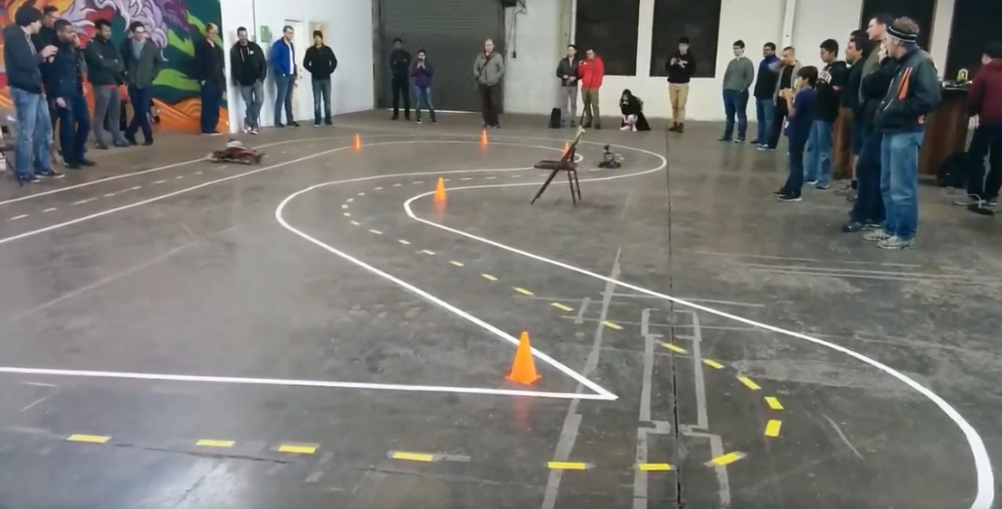
Community Building
2,500 in Bay Area Meetup

Slide 29
Concept Graph

Slide 30
What did we learn?
Building a AI system that classisies

